Slide 1
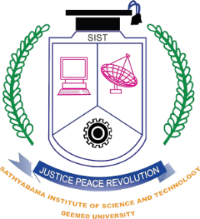

SATHYABAMA
INSTITUTE OF SCIENCE AND TECHNOLOGY
(DEEMED TO BE UNIVERSITY)
Accredited with Grade “A++” by NAAC | 12B Status by UGC | Approved by AICTE
SCSBDPROJ – Design Thinking and Innovations
Wearable power : Energy harnessing for the future
by
M. Vaibhav Varshith – [43611255]
Krishika Soni – [43611236]
Sanjana Kumari – [43611233]
Mandla Ganesh Kumar – [43611259]
Konka Sudheer – [43611244]
Harsh Pandey – [43611274]
Team

Slide 2
Abstract Of Our Project
In today’s digital age, portable electronic devices such as smartphones, smartwatches, and fitness trackers have become essential in daily life. However, these devices require frequent charging, which can be inconvenient, particularly in remote areas with limited access to power sources. Traditional charging methods rely on electrical grids or portable power banks, which may not always be available or sustainable.
The growing dependence on electronic devices highlights the need for alternative and sustainable energy sources. People engage in continuous physical activities such as walking, running, and hand movements, which produce kinetic energy that often goes unused. Harnessing this energy can provide an innovative solution for charging small electronic devices without the need for conventional power sources.
This project aims to design and develop a wearable energy harvesting system that captures kinetic energy from body movements, converts it into electrical energy, and stores it in a rechargeable battery. The stored energy can then be used to wirelessly charge small devices, reducing reliance on traditional charging methods.

Slide 3
Objectives of the project
Convert Mechanical to Electrical Energy – Captures body movements like walking or running and
converts them into usable power.
2. Sustainable Power Source – Provides a renewable energy supply for wearable and portable devices.
3. Enhance Energy Efficiency – Maximizes energy conversion to ensure continuous power output.
4. Enable Health Monitoring – Powers fitness trackers, medical sensors, and other health-monitoring
devices.
5. Reduce Environmental Impact – Minimizes battery waste and reliance on non-renewable resources.
6. Ensure User Comfort – Designed to be lightweight, ergonomic, and easily wearable.
7. Support Multiple Applications – Used in smart textiles, medical devices, and IoT applications.

Slide 4
Block Diagram of Our wearable device
Human Motion
(Walking, Running,
Arm Movements)
Energy Harvesting Unit (Piezoelectric, Electromagnetic, Triboelectric)
Energy Conditioning Circuit
(AC-DC) , Rectifier,
Regulator)
Wearable Device
(Sensors, IoT Devices, LED)
Energy Storage
(Battery, Supercapacitor)
Wireless Charging
Receiver
Wireless Charging
Transmitter
Power Management
System

Slide 5

Architecture Diagram of Our wearable device
KINETIC ENERGY HARVESTING SYSTEM
Structural Generator
Energy
Human Harvesting Generator
Piezoelectric sensors
Generator
Triboelectric generator
Rectifier
Human Generation
Generator
Structural Generator
Generator
Capacitor
Charge Seperation Generator
Charge Seperation Generator

Slide 6
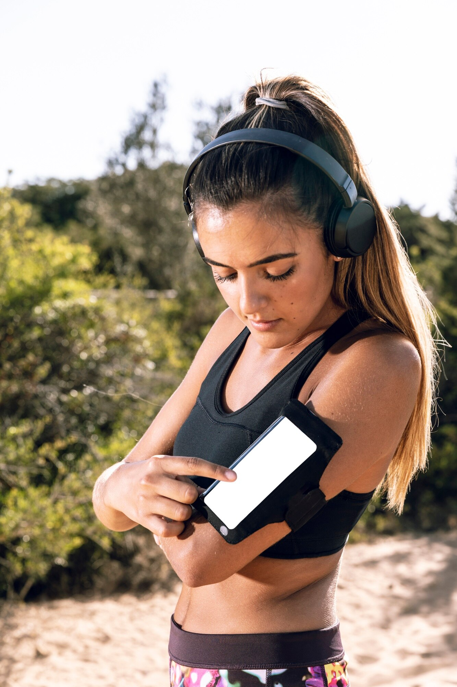
Applications of wearable power
Wearable power has vast applications, from health monitoring to smart clothing. Devices powered by renewable energy can track fitness, monitor vital signs, and even assist in emergency situations. This technology not only promotes sustainability but also enhances user experience and convenience.
Wearable Electronics - Powering smartwatches, fitness trackers, and wearable medical devices.
Healthcare and Medical Devices - Smart prosthetics and exoskeletons that generate power from user movement.
Sports and Fitness - Self-powered smart clothing and shoes that track movement and performance.
Military and Defence - Powering communication devices, sensors, and GPS units in soldiers’ gear.

Slide 7
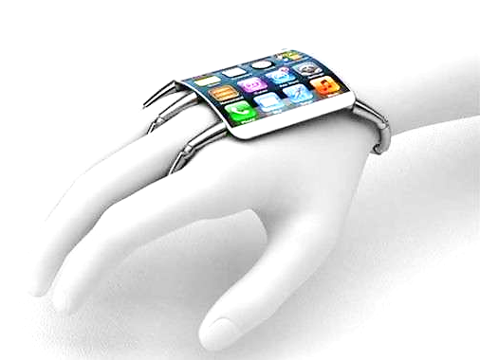
Conclusion : Sustainable future
Harnessing energy through wearable technology is not just a trend; it's a necessity. By integrating renewable energy sources into our daily lives, we can significantly impact our planet's health. The future of wearables lies in their ability to contribute to a sustainable lifestyle for all.

